Slide 1
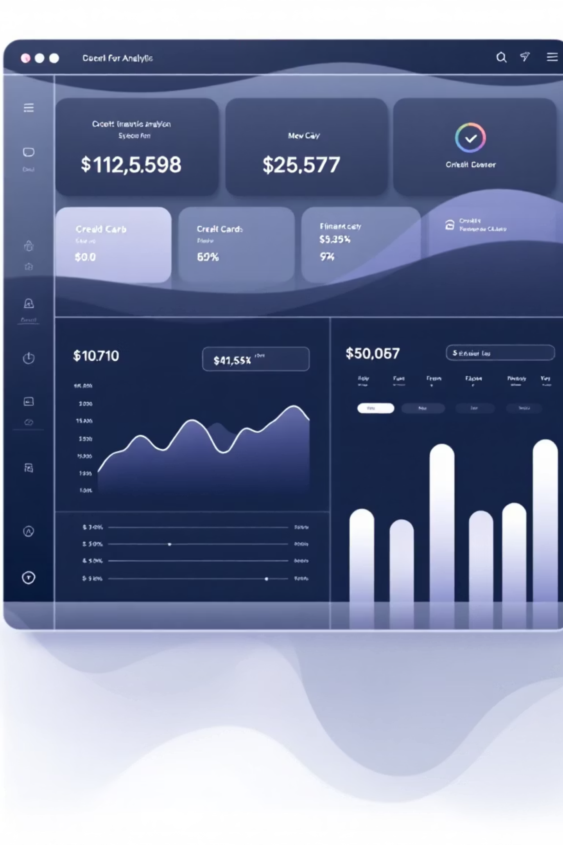
Credit Risk Prediction – Machine Learning Project
By Sudhir Chaudhary | Kaggle Dataset

Slide 2
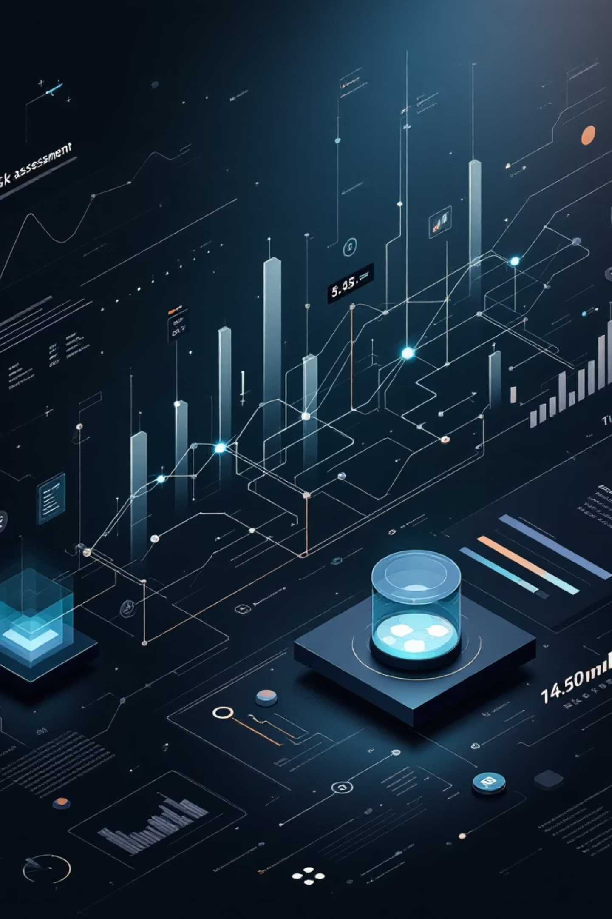

Project Overview
Objective
Dataset
Predict customer loan default risk with machine learning
Kaggle – Give Me Some Credit~150,000 customer records
Target Variable
SeriousDlqin2yrs(Default within 2 years)

Slide 3
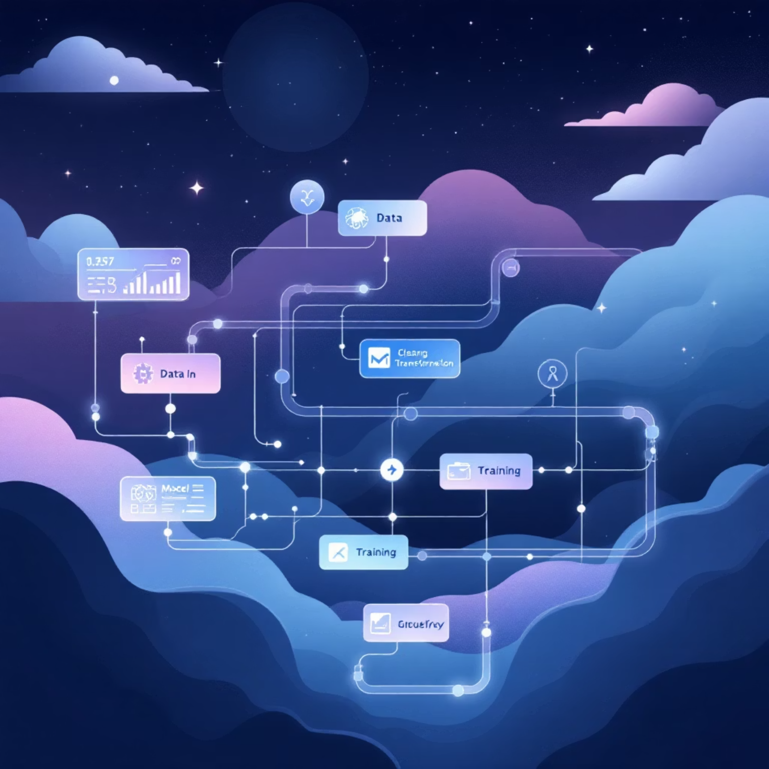
Data Preprocessing
Handling Missing Data
Feature Scaling
Missing values filled with median to maintain data integrity and prevent bias
StandardScaler applied for Logistic Regression model performance
Balancing Classes
Stratified train-test split applied
class_weight="balanced" parameter used

Slide 4

Models Used
Logistic Regression
1
Feature scaling required
Balanced class weights implemented
Linear decision boundary
Random Forest Classifier
Best overall performance
2
Handles non-linear relationships
Superior imbalance handling
Ensemble learning approach

Slide 5
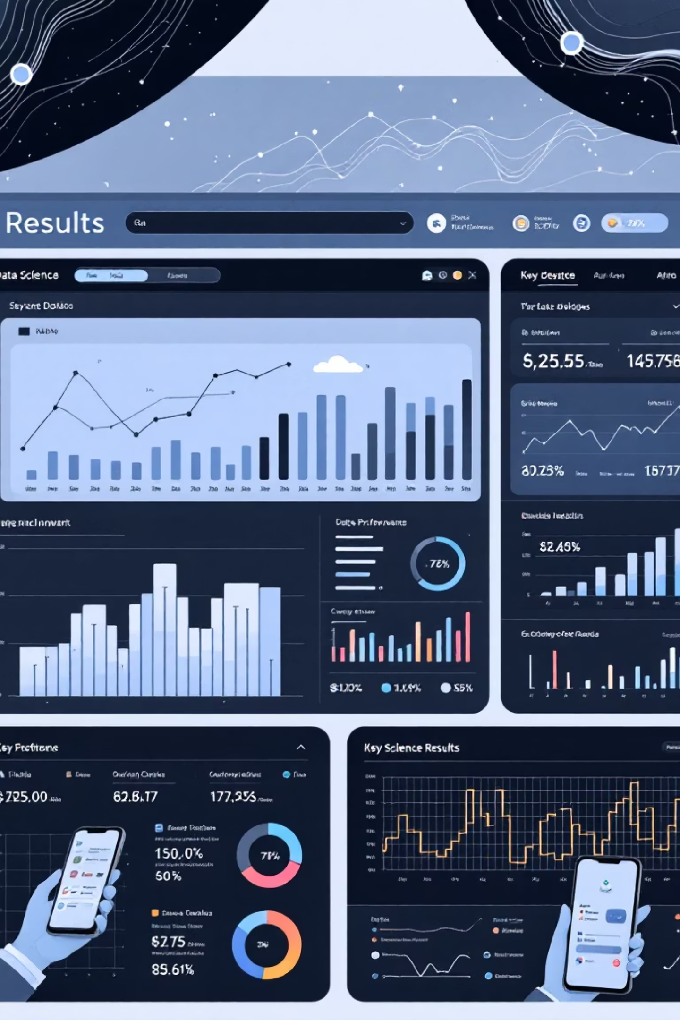
Best Model Results
Random Forest Classifier delivered exceptional predictive performance
0.84
94%
High
AUC Score
Accuracy
Recall
Strong discriminative ability between classes
Overall prediction correctness
Effective default class detection

Slide 6

Feature Importance
Top factors driving credit default predictions
Age
Customer age impact on creditworthiness
OpenCreditLines
Number of active credit lines
DebtRatio
Monthly debt to income ratio
NumberOfTimes90DaysLate
Severe delinquency history
RevolvingUtilizationOfUnsecuredLines
Credit utilization – strongest predictor

Slide 7

SHAP Explainability
Model Transparency
SHAP values reveal feature impact on individual predictions
Bar summary plot visualization
Feature contribution analysis
Business-friendly interpretations
Why it matters: Builds stakeholder trust and regulatory compliance

Slide 8
Business Impact
Early Risk Detection
Loss Reduction
Identify high-risk customers before loan approval, reducing exposure
Minimize loan default losses through proactive risk management
Data-Driven Decisions
Customer Segmentation
Support intelligent loan approvals with predictive insights
Improve targeting and personalized financial products

